Slide 1
Growth Mindset day 3
Room 123

Slide 2
Patterns in Numbers (12– 15 minutes)
To be turned in:
Expand the pattern to 50.

Slide 3
Expand the pattern to 50.

Slide 4
Patterns Video (5 minutes)
www.youcubed.org/wim-day-4/

Slide 5
Pascal’s Triangle (20 – 30 minutes)
1.) Complete Pascal’s Triangle.
2.) Find the sum of each row in Pascal’s Triangle. Is there a pattern?
3.) Shade all of the odd numbers in Pascal’s Triangle. Is there a pattern?

Slide 6
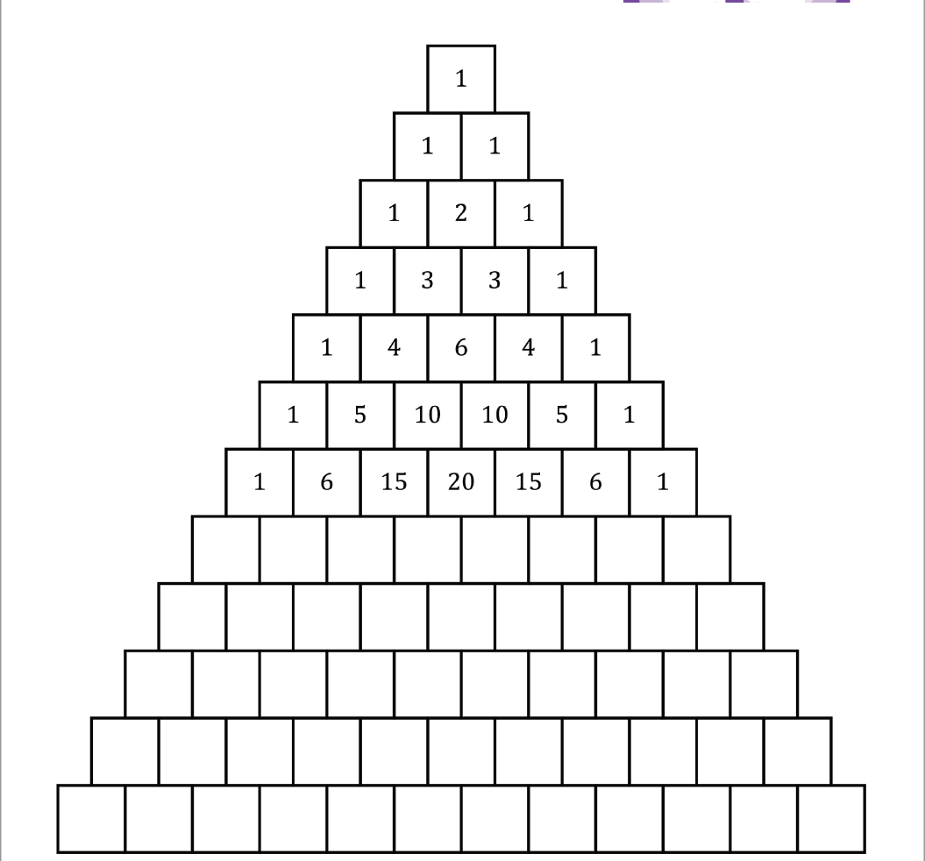

Slide 7
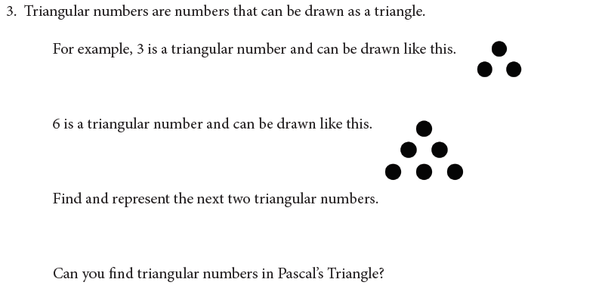
4.) Describe one more pattern that you discovered
within Pascal’s Triangle.

Slide 9
What is the connection between these mathematicians?
Fibonacci (c. 1175 – c. 1250) was an Italian mathematician from the Republic of Pisa
Blaise Pascal, born on June 19, 1623 in Clermont-Ferrand, France
Wacław Franciszek Sierpiński (14 March 1882 – 21 October 1969) was a Polish mathematician.

Slide 10
Mistake Video (3 minutes)
www.youcubed.org/wim-day-5/

Slide 11
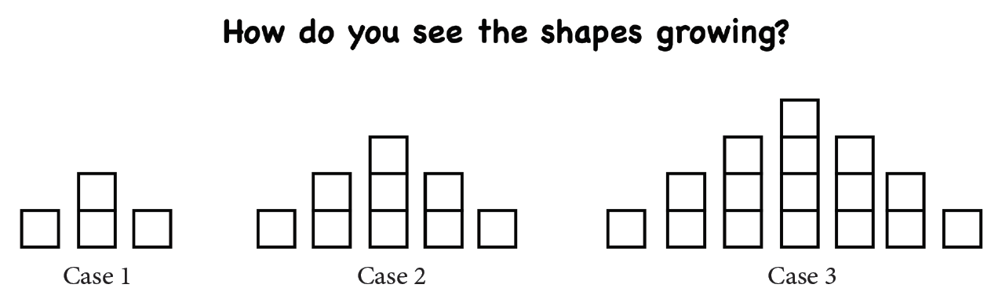
Use colors, shading, and/or words to describe your answer.

Slide 12
How would you complete the chart?
Case Number | Number of Squares
1 | 4
2 | 9
3
4
5
6
15
50
1000
How can you represent this pattern another way?

Slide 13
Exit Ticket
What do you want me to know about you in order to make this year the best year you’ve had in a math classroom?

